Slide 1
CSE 12 – Basic Data Structures and Object-Oriented Design Lecture 18
Greg Miranda, Fall 2020
This lecture is being recorded

Slide 2
Announcements
Quiz 18 due Wednesday @ 9am
Survey 7 due Friday @ 11:59pm
PA6 due Wednesday @ 11:59pm
Exam 2
Released Tuesday 11/24 @ 6pm
Due Wednesday 11/25 @ 11:59pm
Topics:
Cumulative
Big topics
Big O, Big Theta run-time analysis
Sorting algorithms,
Hash tables/maps

Slide 3
Topics
Binary Search Trees
Questions on Lecture 18?

Slide 4
class Node<K,V> {
K key;
V value;
Node<K,V> left;
Node<K,V> right;
public Node(K key, V value,
Node<K,V> left,
Node<K,V> right) {
this.key = key;
this.value = value;
this.left = left;
this.right = right;
}
}
class BST<K, V> {
Node<K, V> root;
BST() (this.root = null);
BST(Node<K, V> root) { this.root = root; }
V get(Node<K, V> node, K key) {
if (node == null) { //throw error }
if (node.key.equals(key)) {
return node.value;
}
if (node.key > key) {
return get(node.left, key);
}
else {
return get(node.right, key);
}
}
V get(Key key) {
return this.get(root, key);
}
}

Slide 5
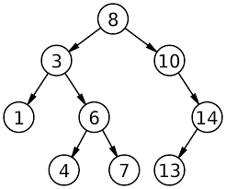
Binary Search Tree
Assume the key and value are identical for this example
Trace the path for get(4)
How many nodes does it touch?
Trace the path for get(2)
How many nodes does it touch?
What happens when the nodes isn’t found?

Slide 6
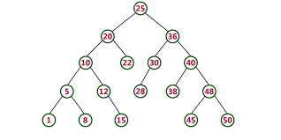
Binary Search Tree
Assume the key and value are identical for this example
Trace the path for get(40)
How many nodes does it touch?
Trace the path for get(4)
How many nodes does it touch?

Slide 7
Questions on Lecture 18?

